Slide 1

HelpDesk (ResoDesk)
NOVEMBER 2022

Slide 2

Content
1
About the HelpDesk (ResoDesk)
2
ResoDesk Dashboards
3
Ticket Request
4
Viewing Requests
5
Agent rating

Slide 3
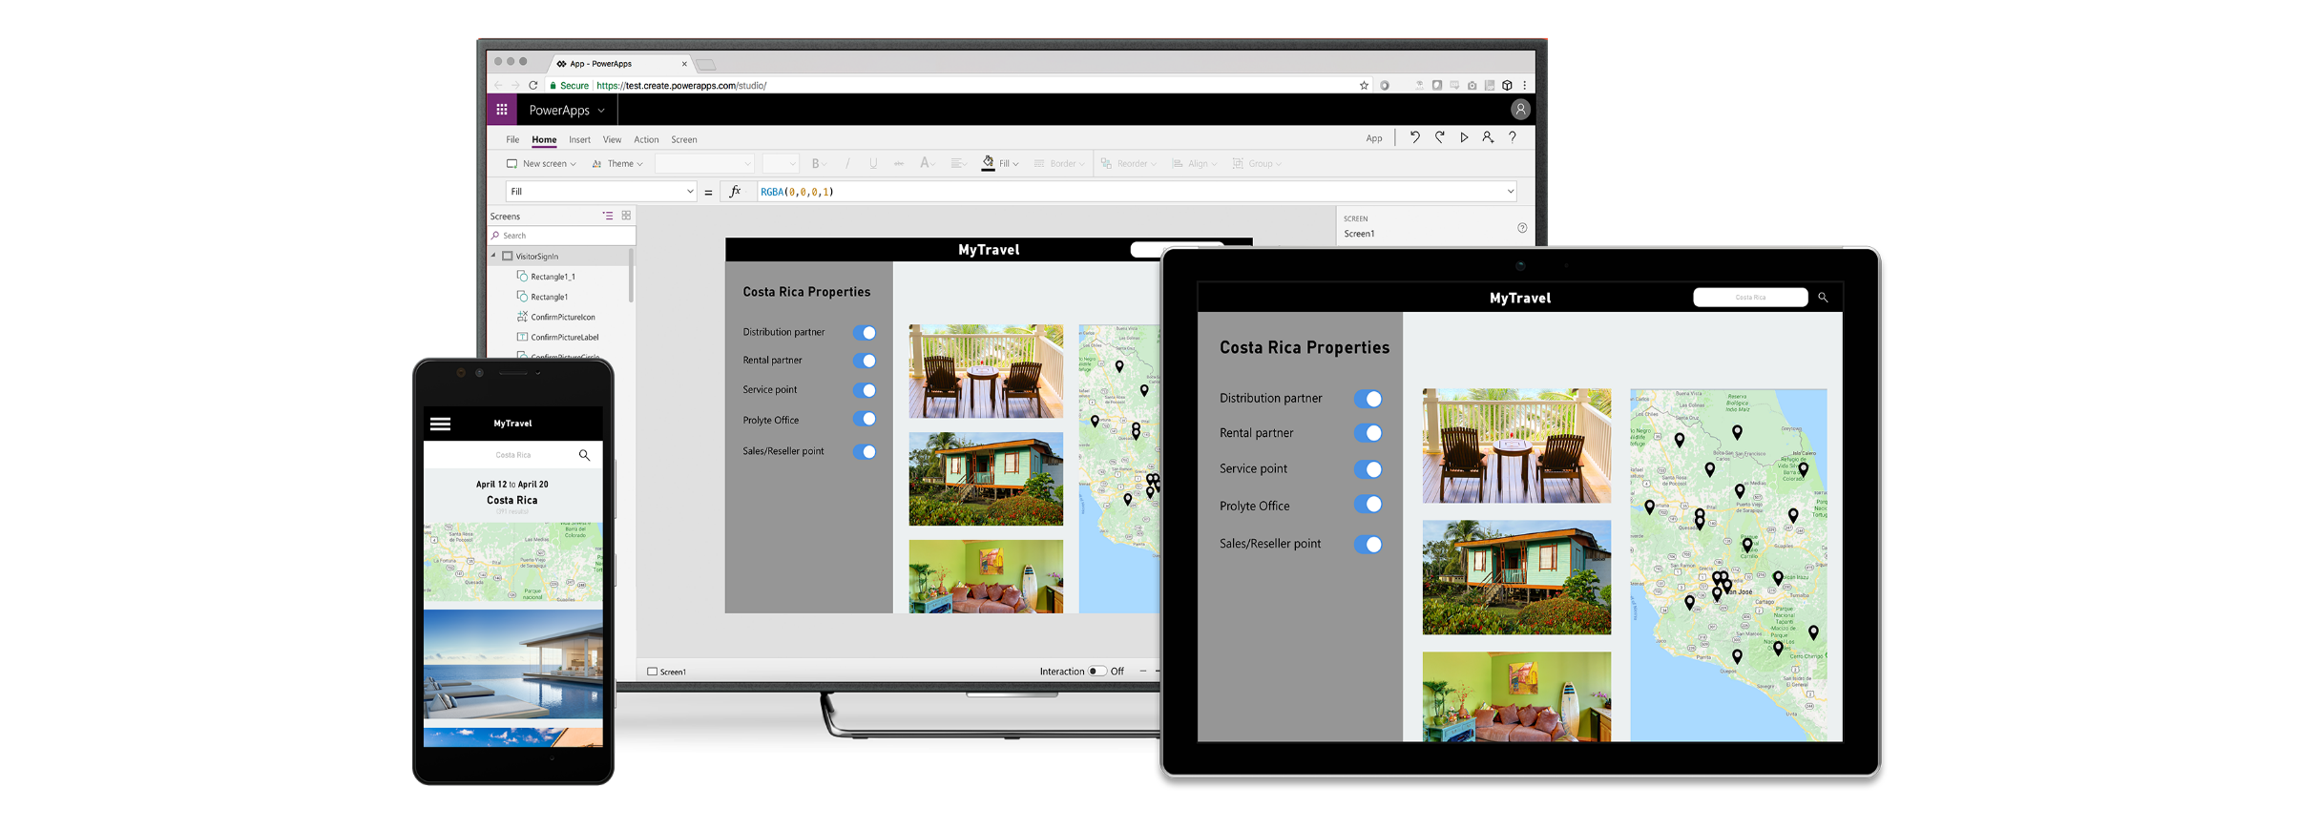
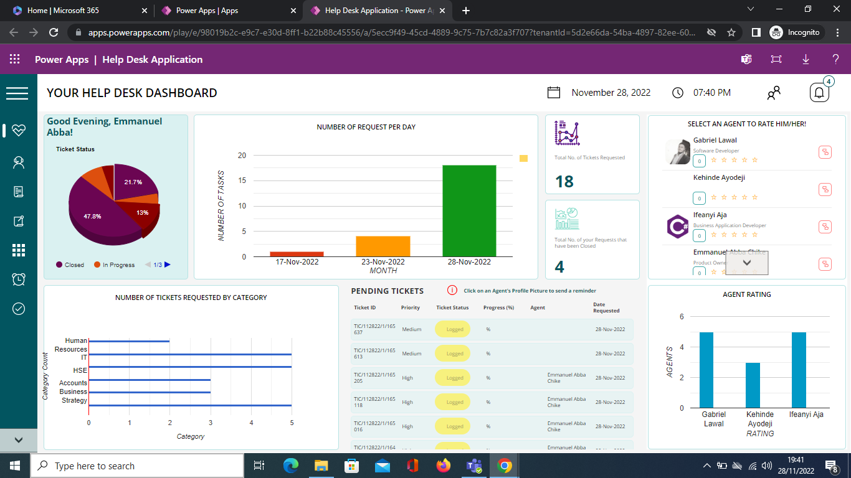
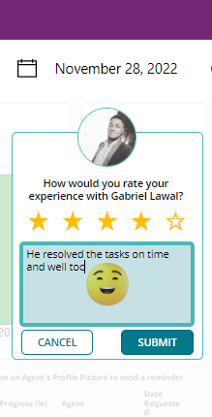
About ResoDesk
ResoDesk is designed to track all complaints and manage the entire incident lifecycle
The cloud-based help desk software also helps get real-time insight into the complaints received from employees and how the help desk team is performing.
ResoDesk adopts the problem ownership feature to ensure quick and efficient problem resolution while keeping the complainant fully abreast of the progress being made and who is responsible per time.
Studies reveal that huge revenue is lost annually due to poor problem response to service disruptors within an organization.
The workplace needs an automated issue logging system that assigns problems to solutions, tracks their progress, and follows through until the problem is resolved. Without introducing complexity, easy to use, can connect with any pre-built integrations, grant oversight of all issues with their severity

Slide 4
Why ResoDesk?
Reduce problem resolution time to the barest minimum by managing incident lifecycle
Enhance ownership of problems to foster taking responsibility.
INCIDENT LIFECYCLE MANAGEMENT
Increase real-time tracking of problems and service disruptors for trending, analysis and workload balancing
Benefits
PROBLEM OWNERSHIP
To eliminate bureaucracy through proper problem routing
BOOST HELP DESK TEAM PRODUCTIVITY
Track the competence and productivity of technicians and help desk team.

Slide 5

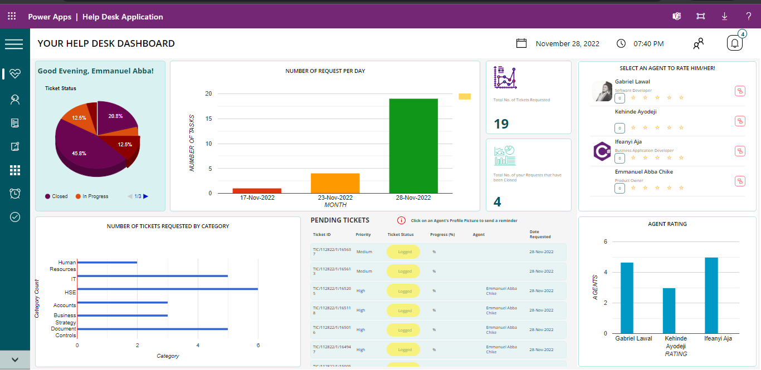
Rich Personalized Dashboard
A personalized dashboard that summarizes employee ticketing
Benefits
Quickly view all pending requests/tickets and who is responsible for the resolution
Summarizes engagement activities for help desk agents to track issues by priority and service level agreements

Slide 6

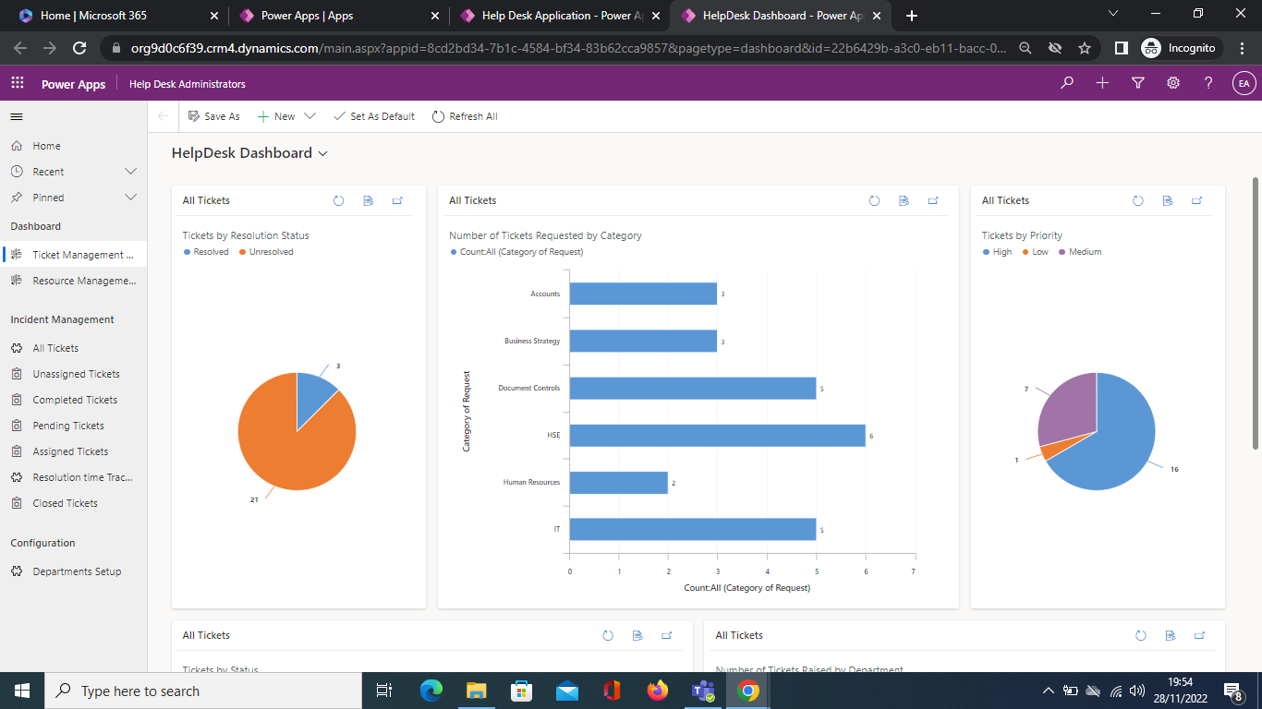
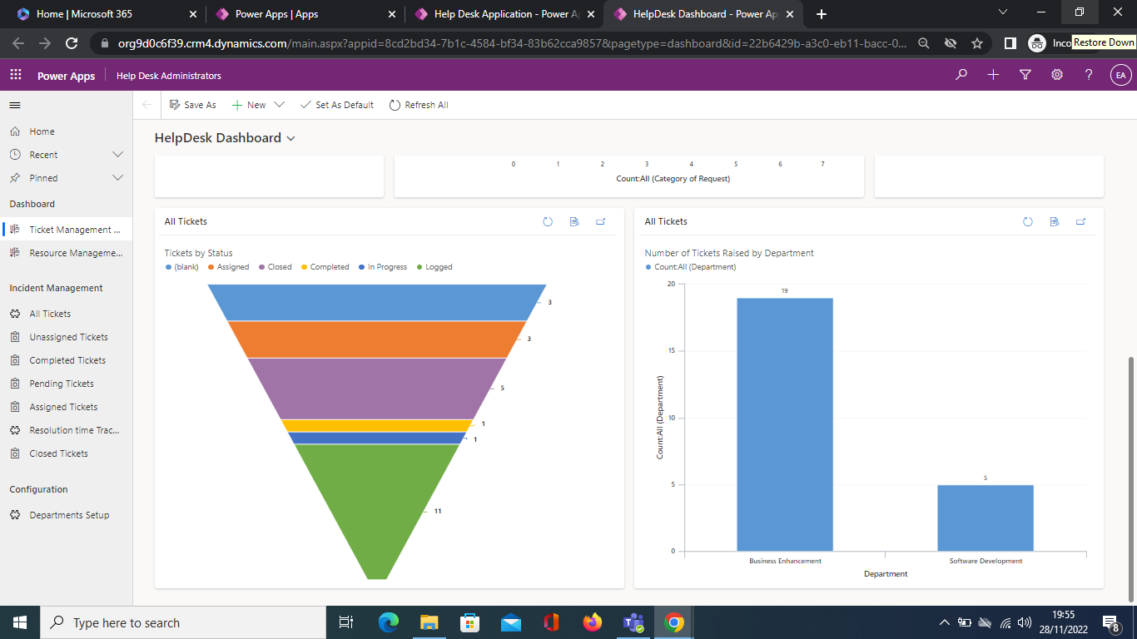
A Super Admin View
A super Admin view enables the IT/help-desk manager to have a complete view of the entire helpdesk activities
Benefits
View all issue logged by department to evaluate resolution speed and SLA compliance
View all high priority issues to track their resolution

Slide 7
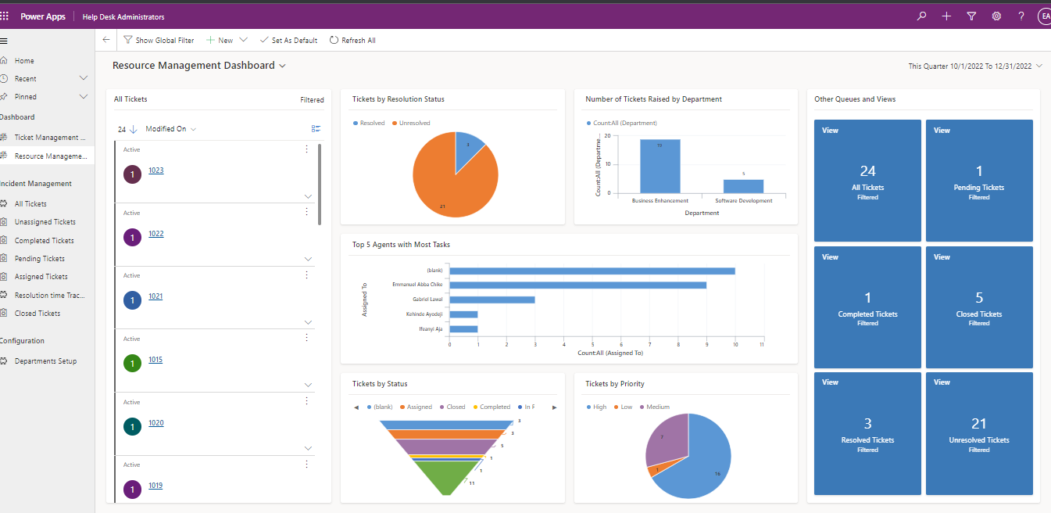
A Super Admin View
Benefits
Evaluate all tasks assigned to help desk agents to implement load balancing
View all tickets that there are in the system to check for trends and patterns
Track all incidents by departments to know when to trigger alternative resolution means.

Slide 8

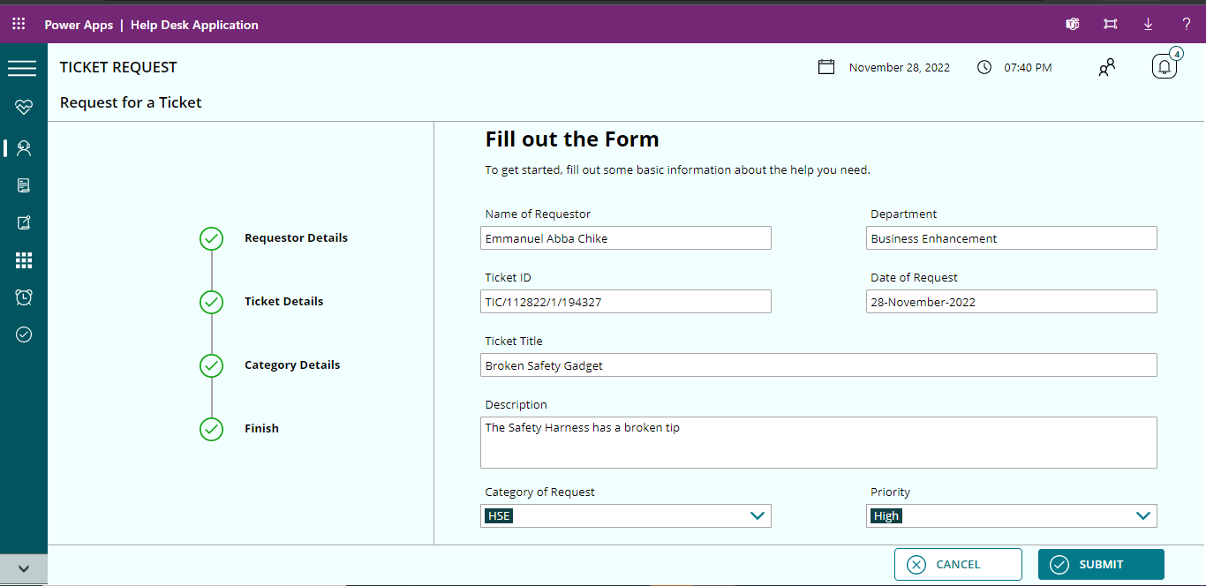

Ticket Request
A user interface friendly ticket raising form
Benefits
Automatically extracts employee’s detail to pre-fill basic portions of ticket
Detailed issue reporting with priority feature
Automatic issue routing

Slide 9


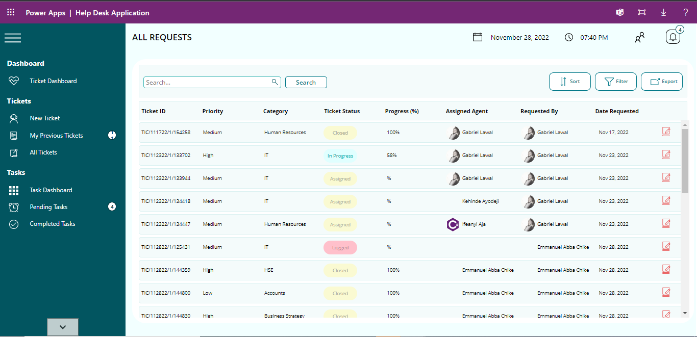
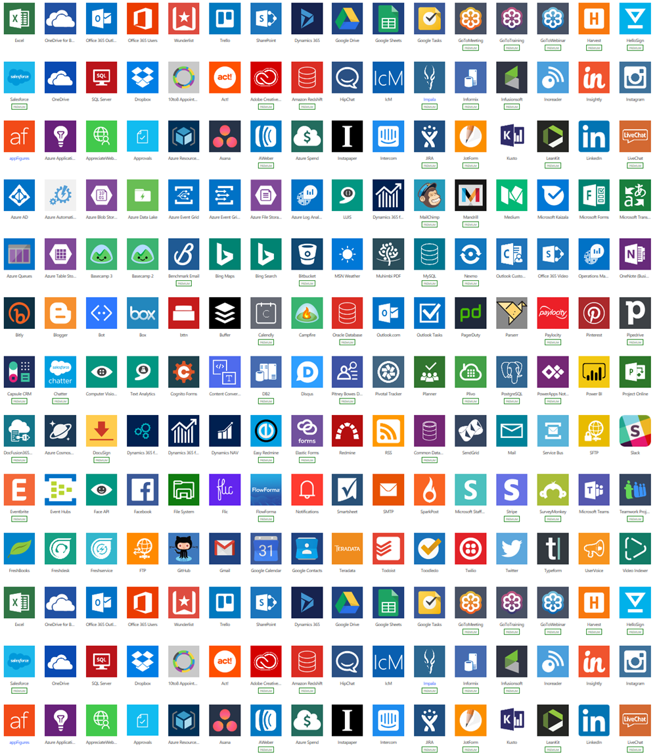
View all Requests
Employees can view all request schedule
Benefits
Track each issue for resolution
Realtime update on the status of each incident
Know all the agents attached to each ticket
Edit tickets in case of a change in any of the prevailing conditions

Slide 10

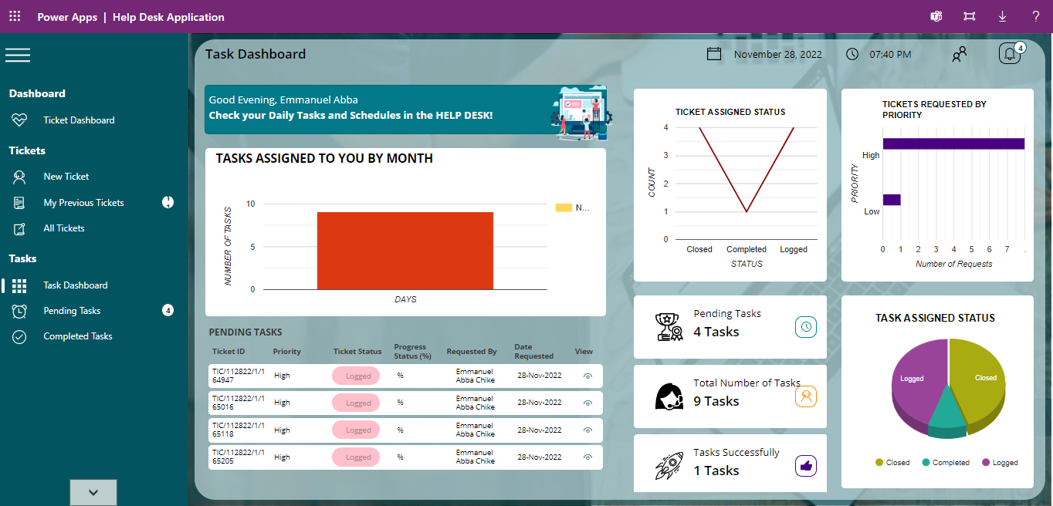
s
Task Dashboard
A very detailed task dashboard for technician
Benefits
Track productivity per day by evaluating achievement and tickets closure
Quick view of all pending tasks; to provide updates as work progresses
Also weigh task bucket to ascertain emergencies

Slide 11

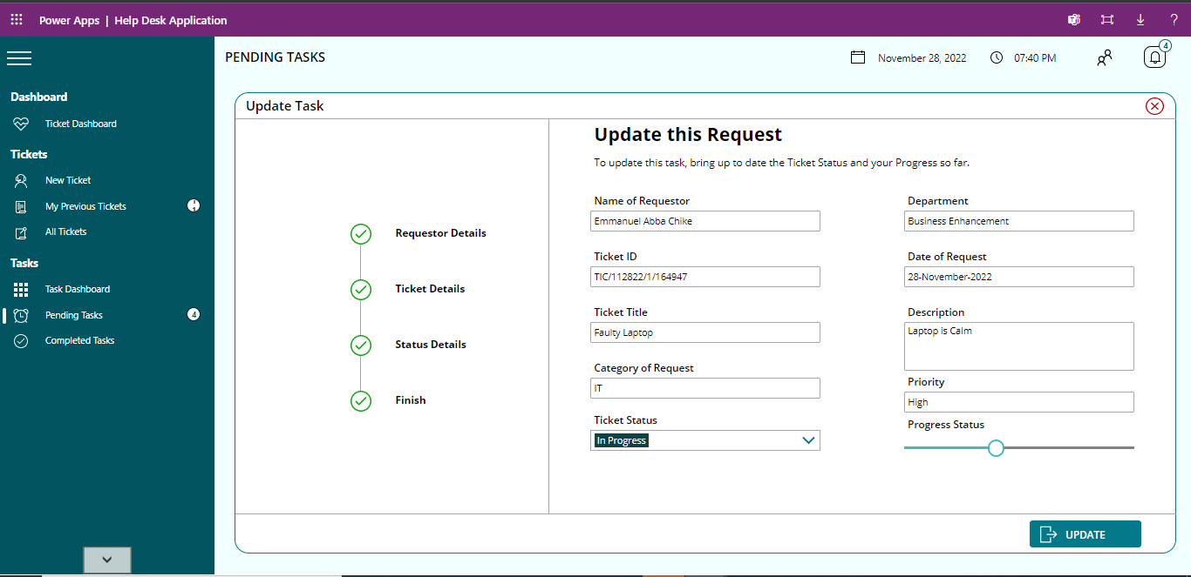
Update Request/ Rate Agent
Agents can provide update on issue progress.
Benefits
Agents can provide real-time update as work progresses
Agents can also be rated by the complainant
Agent ratings can form the yardstick for appraisals and reward

Slide 12
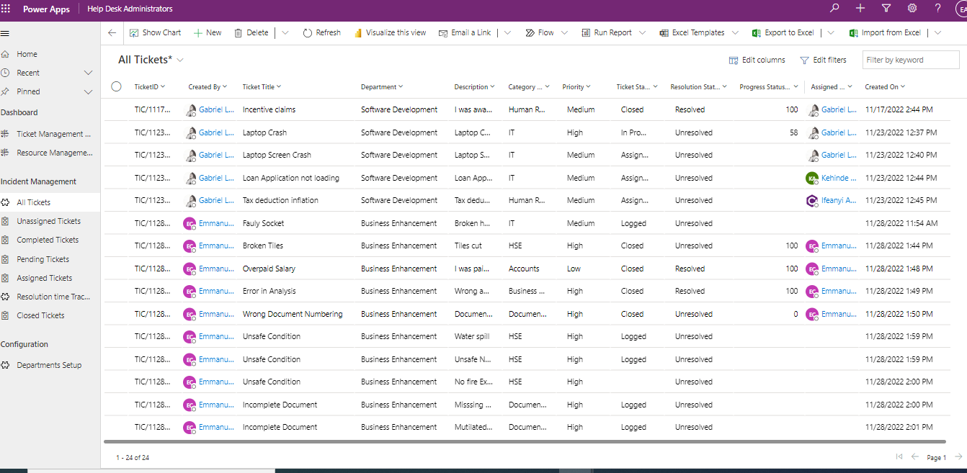

All Tickets- Admin View
Admin can view all tickets across departments
Benefits
Evaluate issues to identify business-impacting ones so as to take proactive actions
View all tickets and accompanying details, alert appropriate agents for unassigned tickets
Utilize data for trending and analysis of issues to trace the root cause

Slide 13
Thank You
© Copyright Reliance Infosystems Limited. All rights reserved.

